Slide 1

HEURIST: A RICH COLLABORATIVE DATABASE
FAIMS STOCKTAKING WORKSHOP | 19 AUG 2012 | UNSW
IAN JOHNSON, ANDREW WILSON & BEATRICE MCLOUGHLIN
ARTS eRSEARCH

Slide 2
What is Heurist?
A generic, abstract, online database tool
Instant creation of complex multi-user databases
Flexible system for defining records, fields, terms, constraints - allows incremental changes
Extensive pointer/relationships capabilities for richly linked and annotated databases
Methods for sharing (internally) and publishing (externally) digital research data
Output as XML, reports, maps, timelines etc.

Slide 3
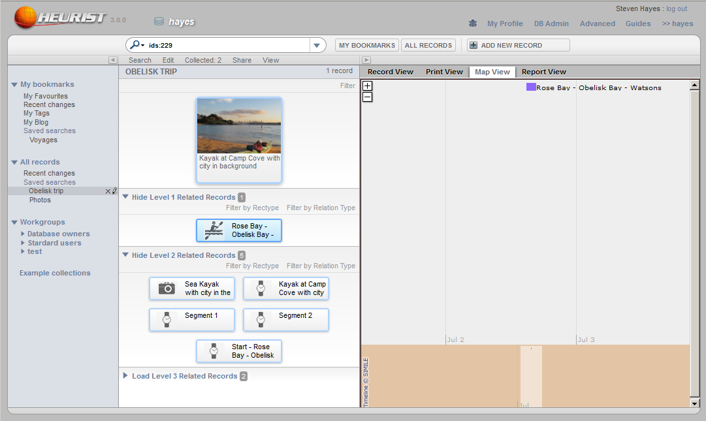
A generic, abstract, online database tool
Navigation
Search
Other functions
Application / Display

Slide 4
What is Heurist?
A generic, abstract, online database tool
Instant creation of complex multi-user databases
Flexible system for defining records, fields, terms, constraints - allows incremental changes
Extensive pointer/relationships capabilities for richly linked and annotated databases
Methods for sharing (internally) and publishing (externally) digital research data
Output as XML, reports, maps, timelines etc.

Slide 5
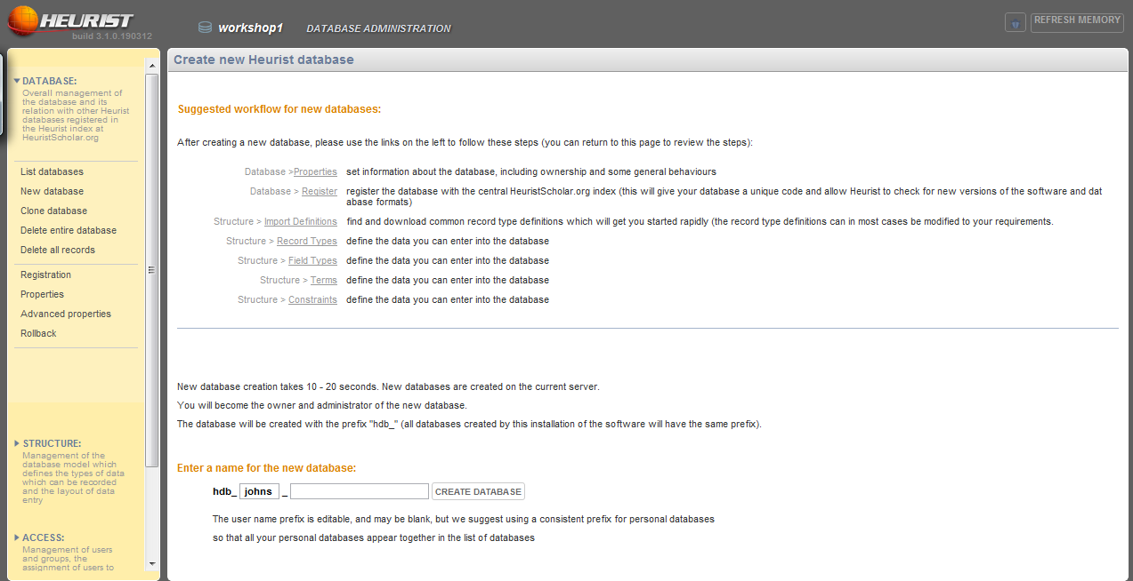
Instant creation of complex multi-user databases

Slide 6
What is Heurist?
A generic, abstract, online database tool
Instant creation of complex multi-user databases
Flexible system for defining records, fields, terms, constraints - allows incremental changes
Extensive pointer/relationships capabilities for richly linked and annotated databases
Methods for sharing (internally) and publishing (externally) digital research data
Output as XML, reports, maps, timelines etc.

Slide 7
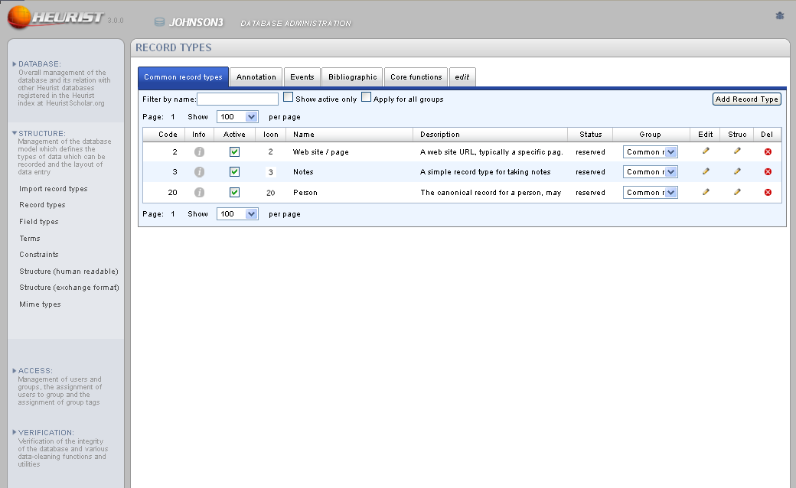
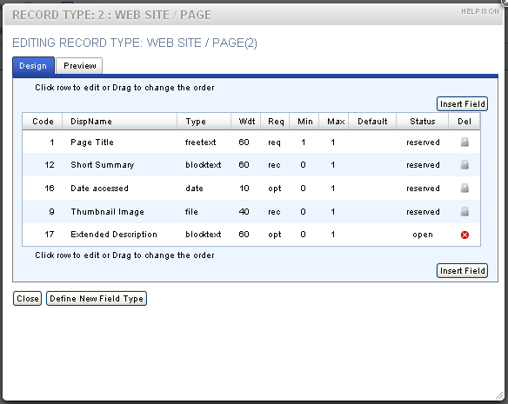
Flexible system for defining records, fields, terms, constraints - allows incremental changes

Slide 8
What is Heurist?
A generic, abstract, online database tool
Instant creation of complex multi-user databases
Flexible system for defining records, fields, terms, constraints - allows incremental changes
Extensive pointer/relationships capabilities for richly linked and annotated databases
Methods for sharing (internally) and publishing (externally) digital research data
Output as XML, reports, maps, timelines etc.

Slide 9
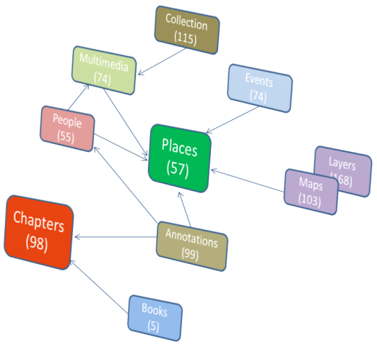
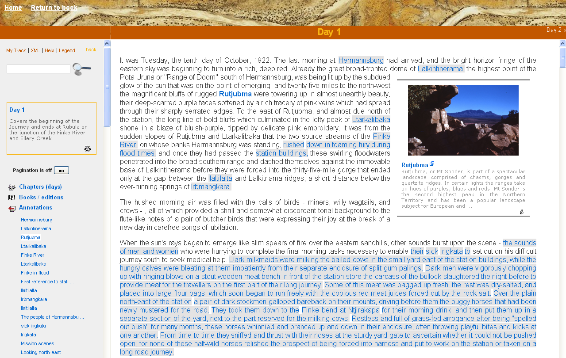
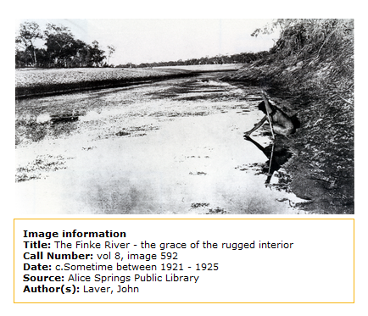
Extensive pointer/relationships capabilities for richly linked and annotated databases

Slide 10
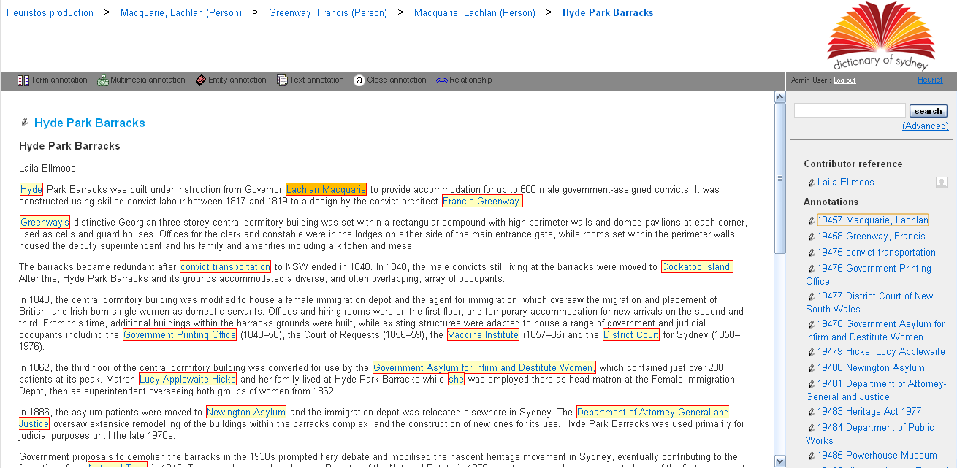
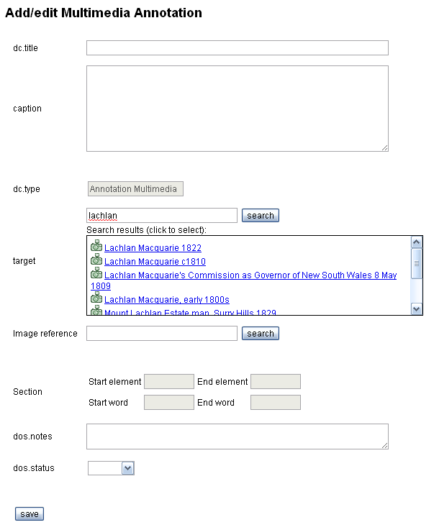
DoS annotation interface

Slide 11
What is Heurist?
A generic, abstract, online database tool
Instant creation of complex multi-user databases
Flexible system for defining records, fields, terms, constraints - allows incremental changes
Extensive pointer/relationships capabilities for richly linked and annotated databases
Methods for sharing (internally) and publishing (externally) digital research data
Output as XML, reports, maps, timelines etc.

Slide 12
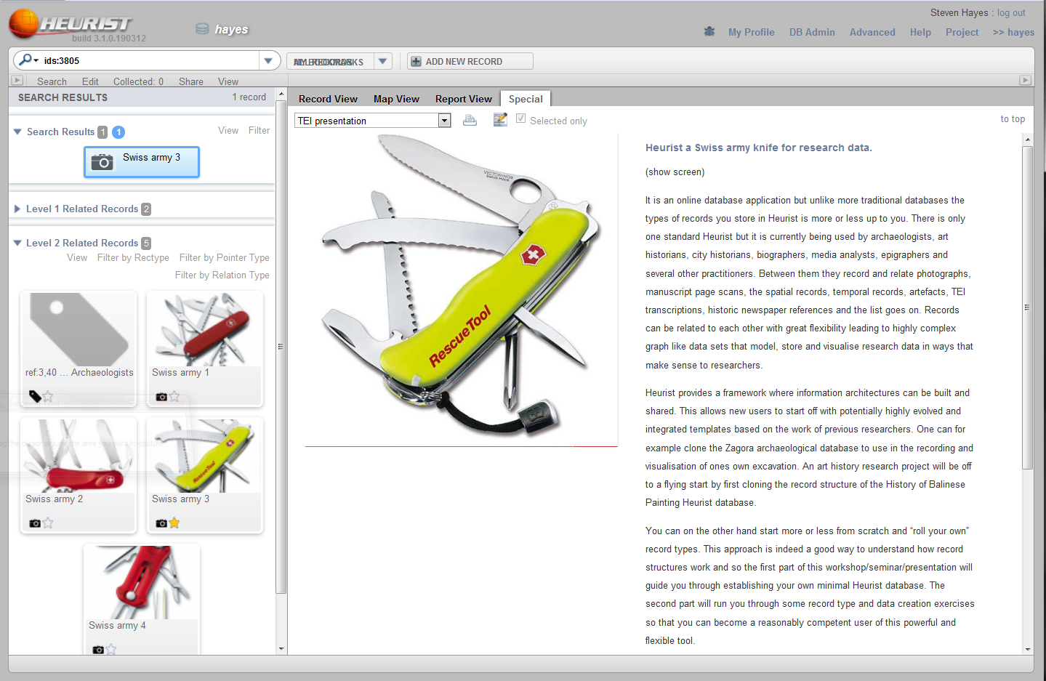
Methods for sharing (internally) and publishing (externally) digital research data

Slide 13
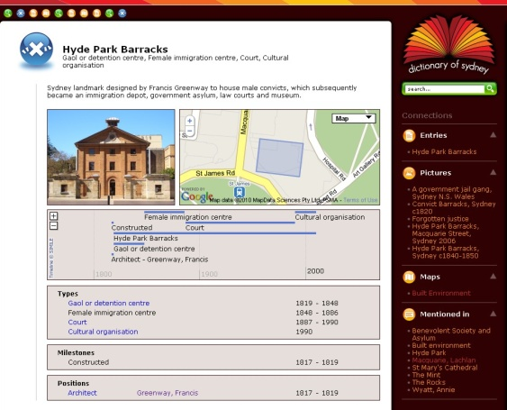

Slide 14
What is Heurist?
A generic, abstract, online database tool
Instant creation of complex multi-user databases
Flexible system for defining records, fields, terms, constraints - allows incremental changes
Extensive pointer/relationships capabilities for richly linked and annotated databases
Methods for sharing (internally) and publishing (externally) digital research data
Output as XML, reports, maps, timelines etc.

Slide 15
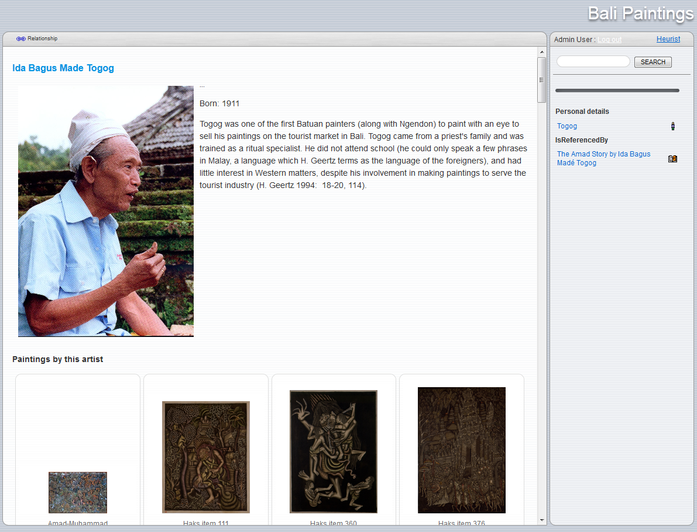
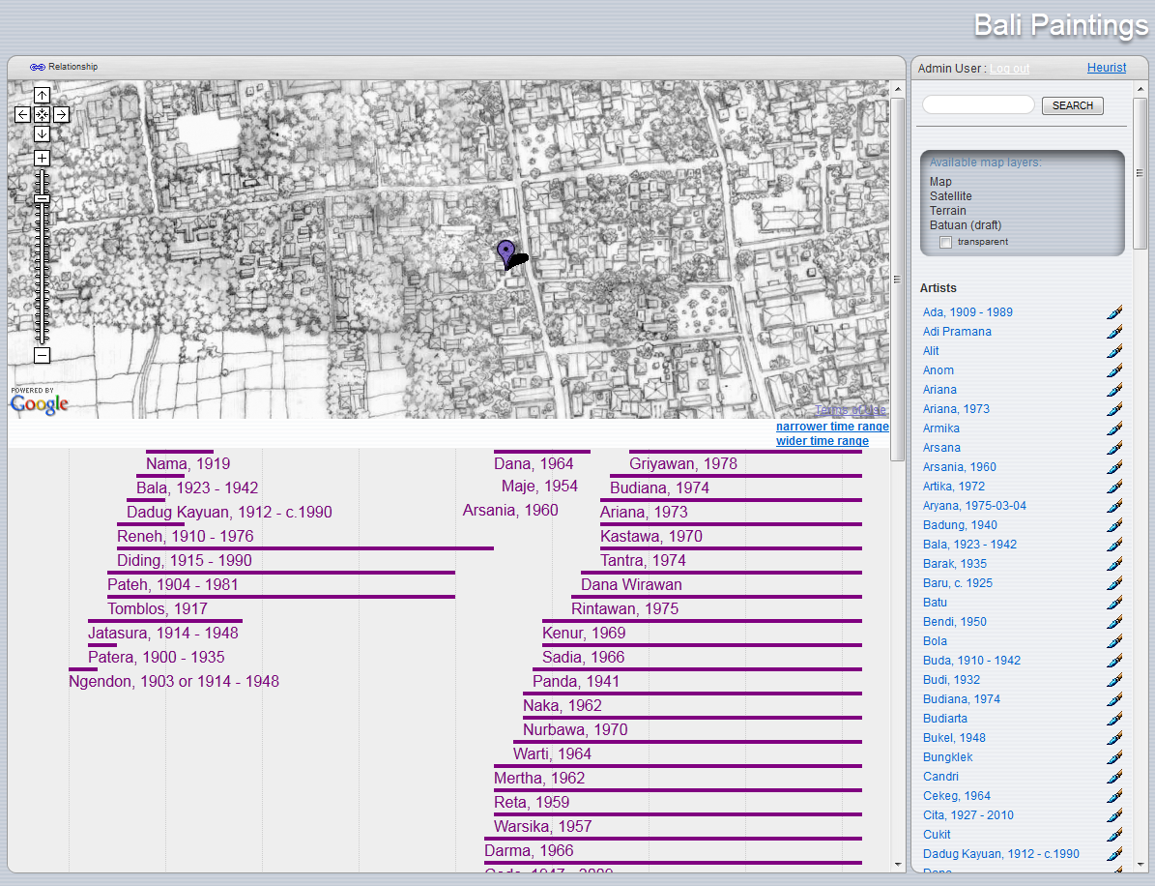
Output as XML, reports, maps, timelines etc.
Bali Paintings database

Slide 16
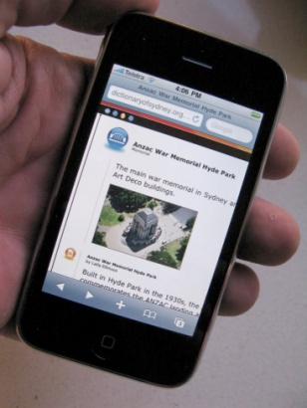
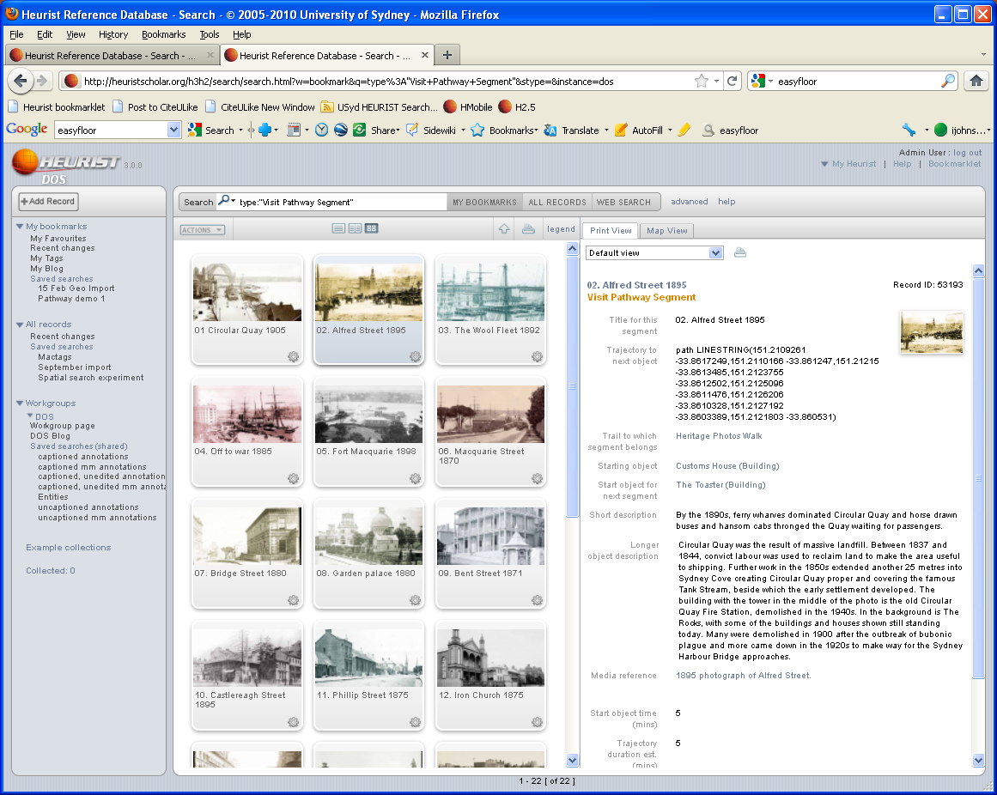
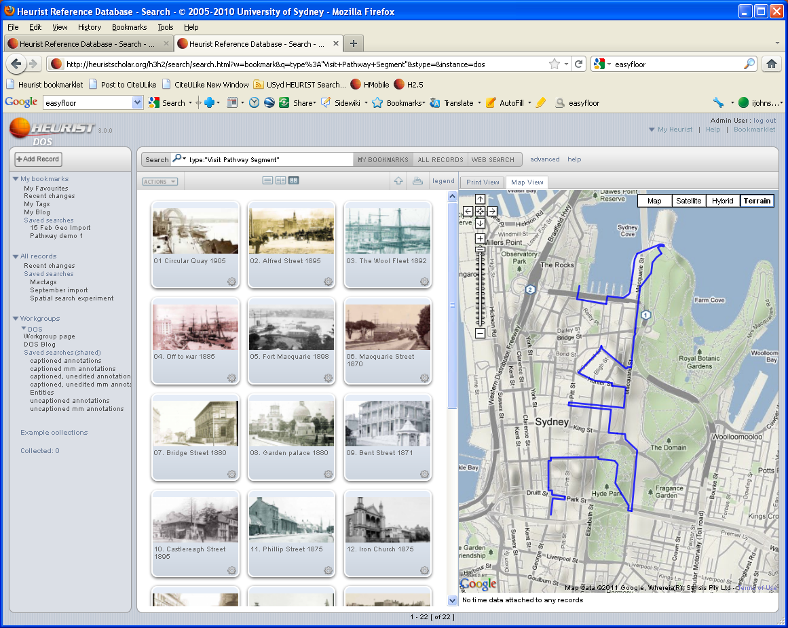
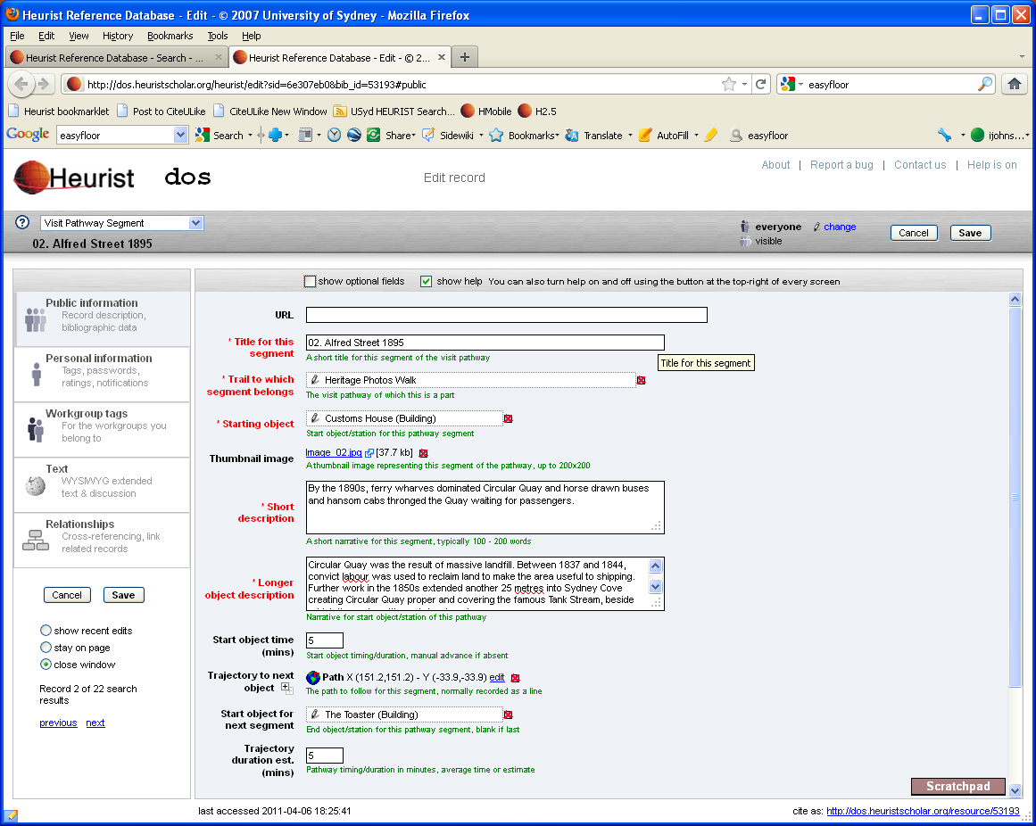

DoS Lite/Mobile

Slide 17
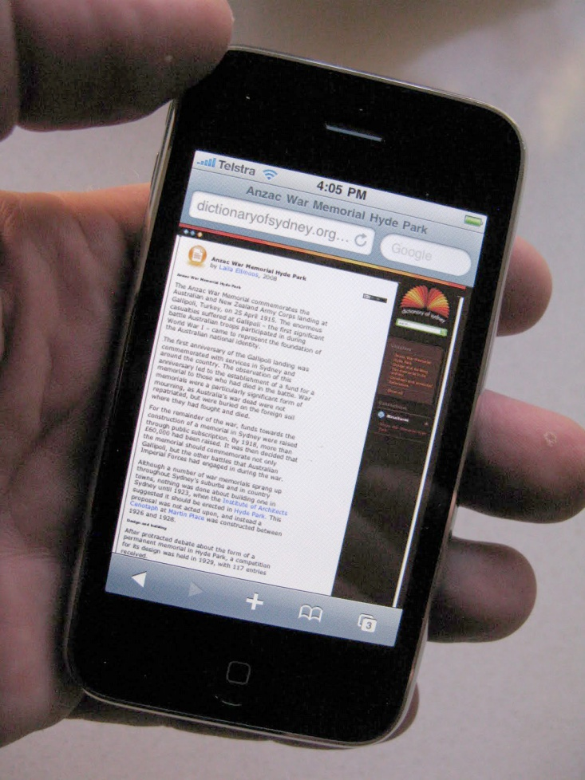

The Dictionary of Sydney Mobile
Small screen version (DoS Lite)
Spatially aware Smartphones
Mobile version (prototype)
QR codes (2D barcodes) to launch application
DoS mobile

Slide 18
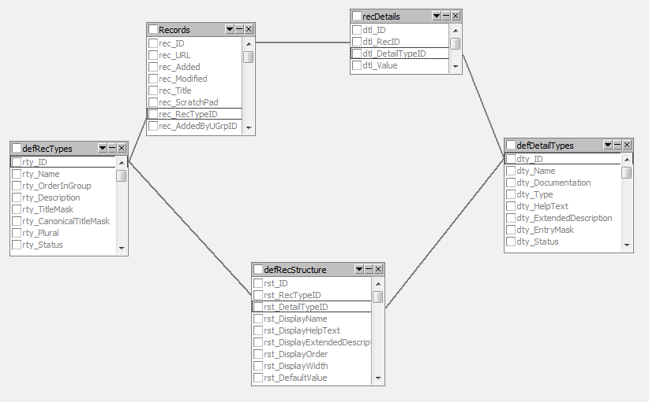
Heurist underlying SQL structure

Slide 19
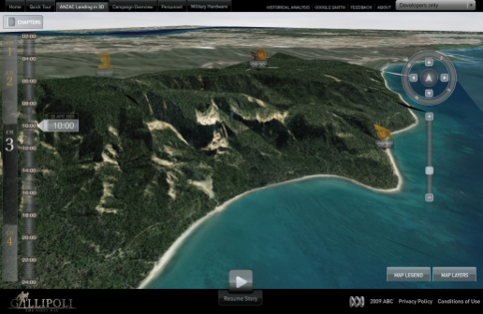
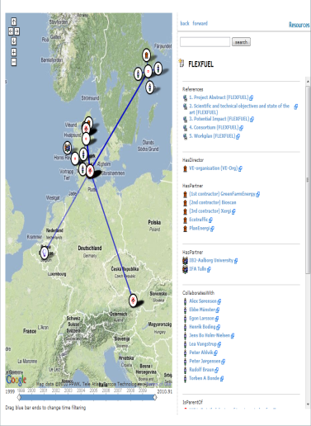
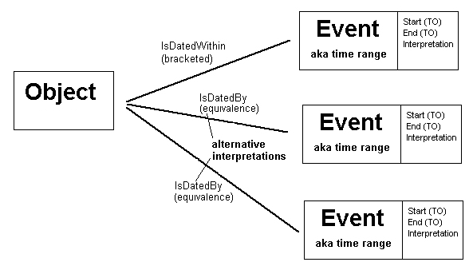
Special features of Heurist
Spatial data
Geographic objects
Temporal data
Methodology for fuzzy dates and interpretation
Relationships
are everything ...

Slide 20
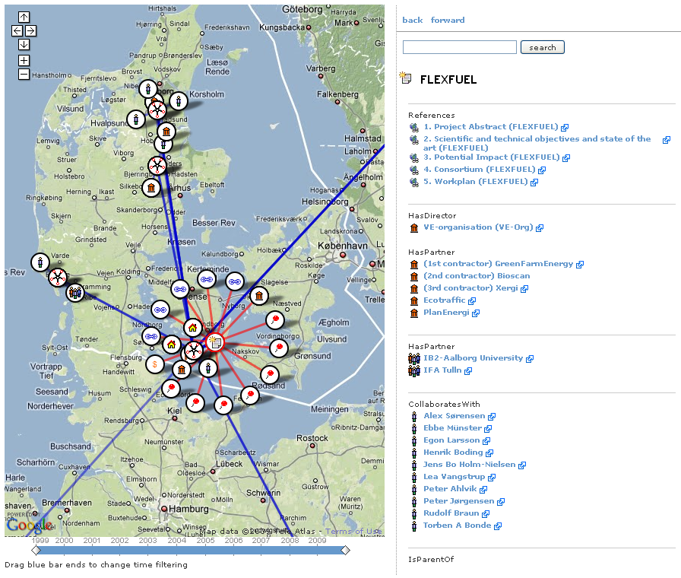
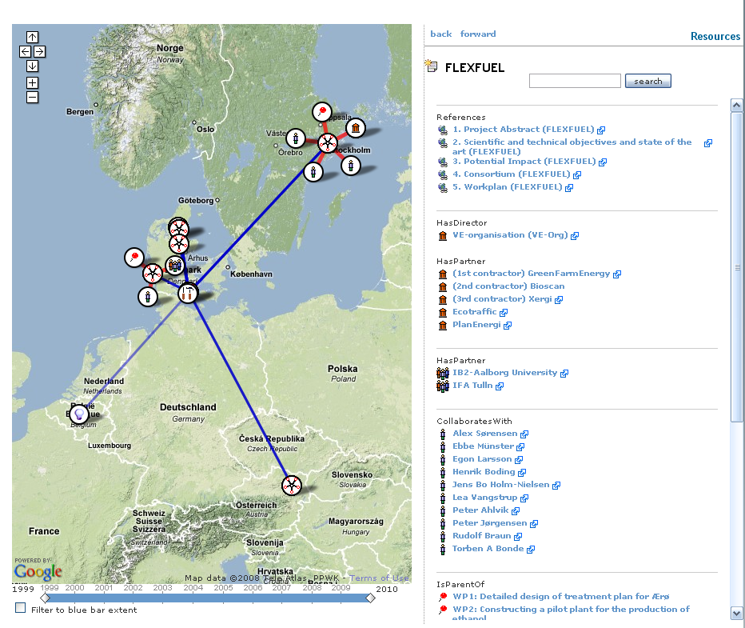
Relationships + space and time

Slide 21
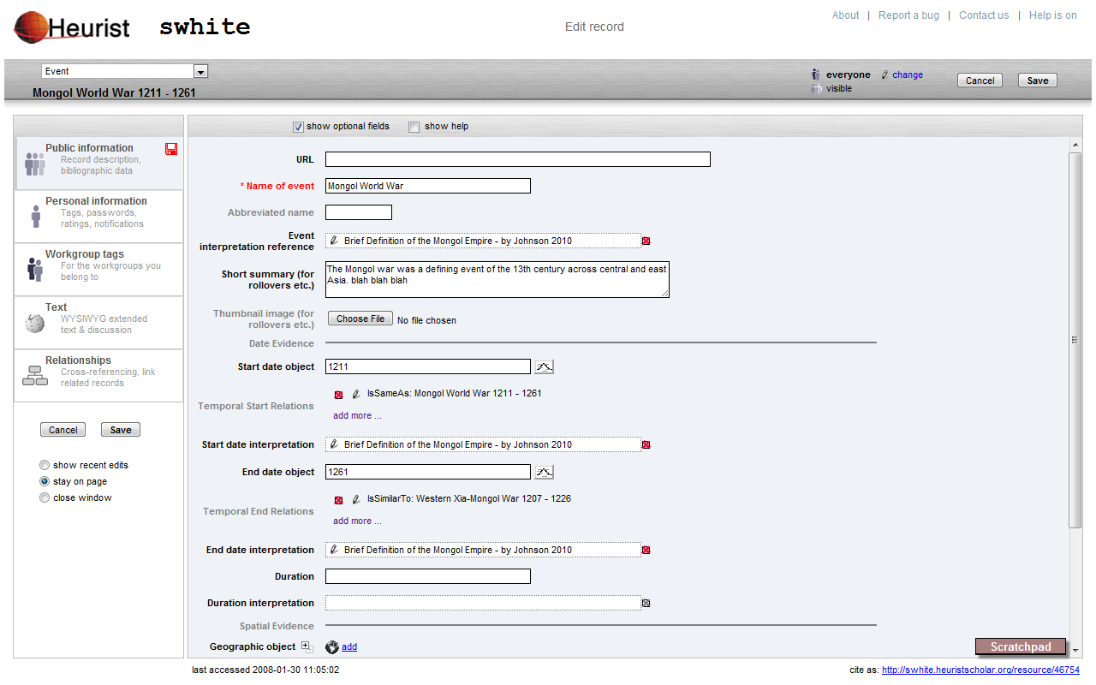
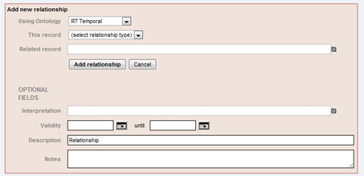
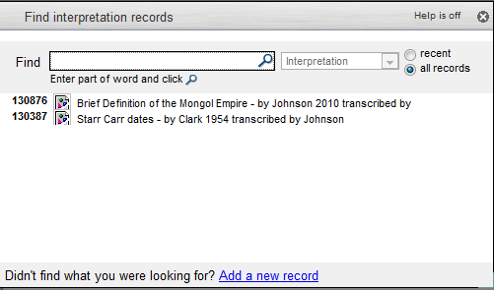
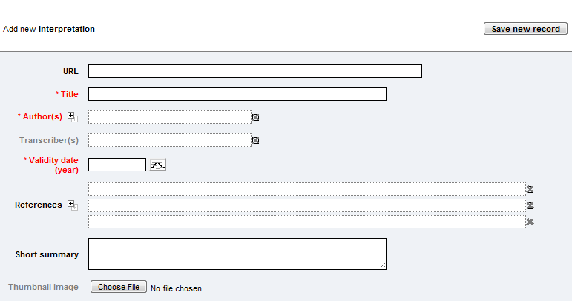
Spatio-temporal model using relationships

Slide 22
Heurist Vsn 3
Academic knowledge management system
“A flexible collaborative eResearch database. Heurist handles a wide variety of digital records describing research objects (from bibliographic records and web bookmarks to historical events and document annotations). Its flexibility is complemented by rich relationship handling, spatial and temporal data, mapping and timeline visualisation.”
Bookmarking, tagging, notes, images
Bibliographic data (fully normalised records)
Blogging (blog posts are just database records)
Users and groups, sharing and collaboration, ownership
Rich online configurable database
Unlimited record types
Rich range of field types: (numeric, terms, text, wysiwyg text, spatial objects, temporal objects, multimedia, record pointers etc.)
Repeatability of fields and requirements (1, 2, …)
Typed relationships between records (all or constrained by type)
Relationship browsing and filtering
Search, saved subsets, saved relationship filters
Publish reports, maps, timelines to web pages

Slide 23
Status of Heurist
Version 3 alpha/beta
Available now for use on our server (some capacity restrictions apply)
Can be installed on most servers (PHP/MySQL/Apache or IIS)
New databases can participate in a peer-to-peer network of Heurist databases
Available to install third quarter 2012, GNU GPL (can be made available now on special request)

Slide 24
SOME IMPLEMENTATIONS
HEURIST: A RICH COLLABORATIVE DATABASE

Slide 25
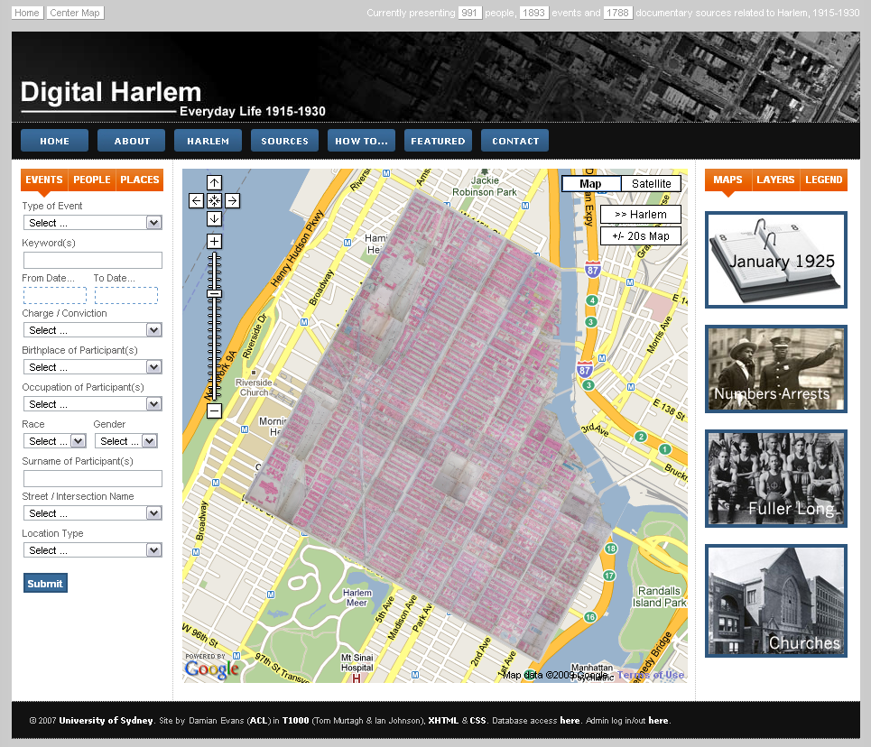
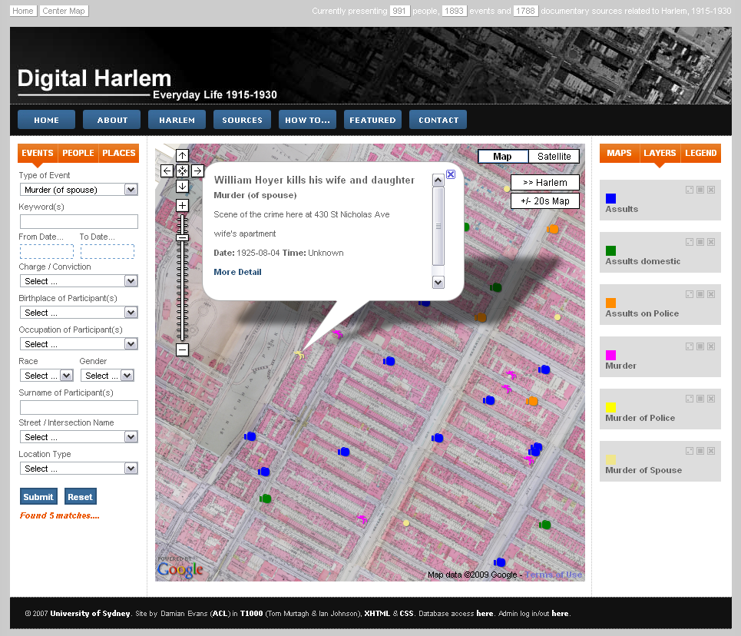
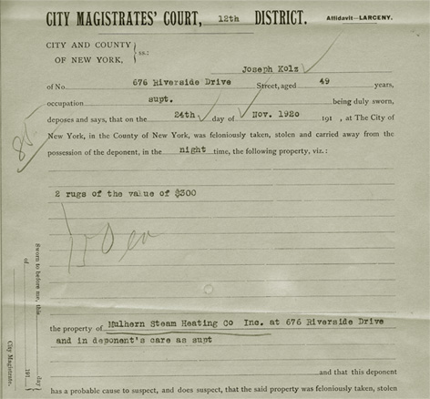
Digital Harlem 1915-1930

Slide 26
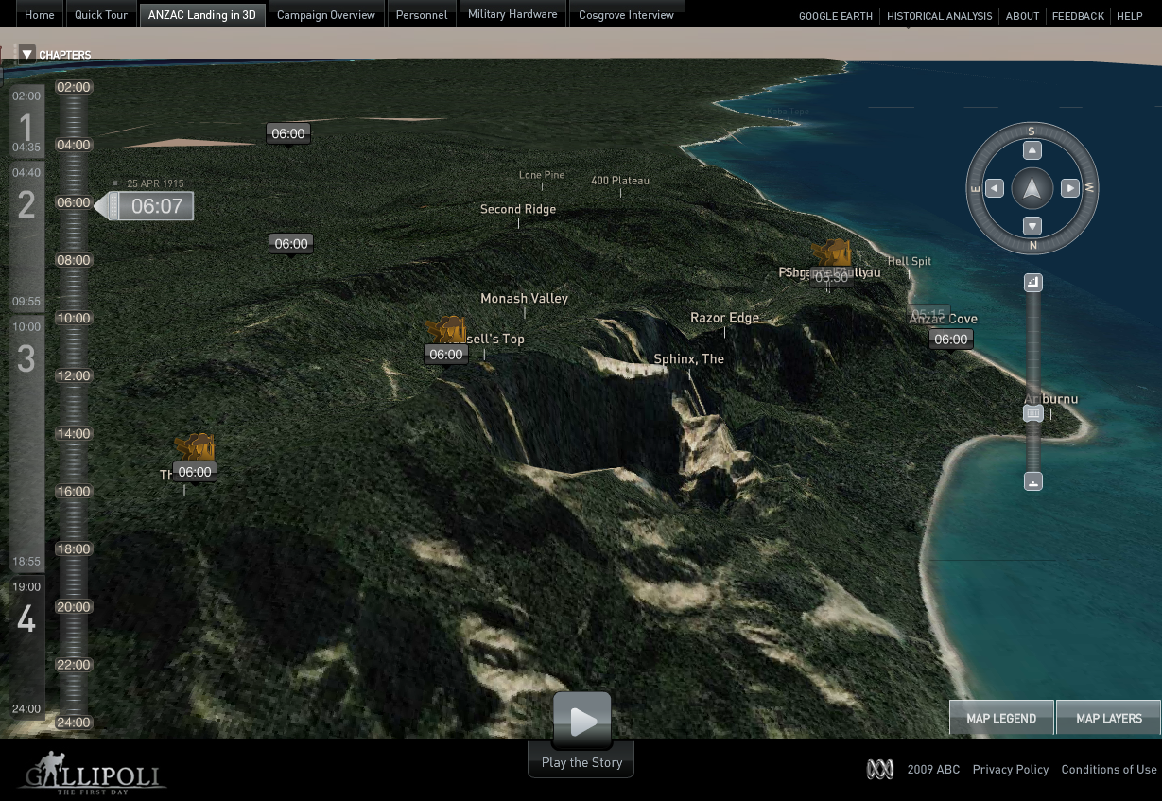
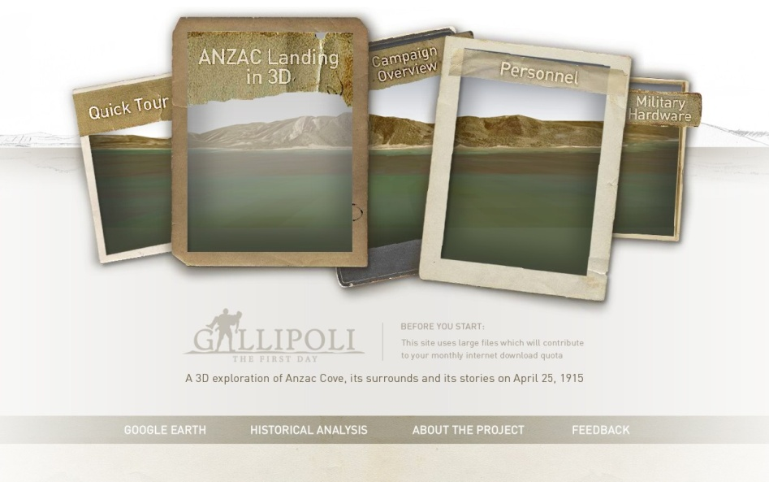
Gallipoli: The First Day
Notes:
We did the back end database and map data – we did not do the voice-overs for the videos – so we got second billing after Hugo Weaving and Lucy Bell. AFI award.

Slide 27
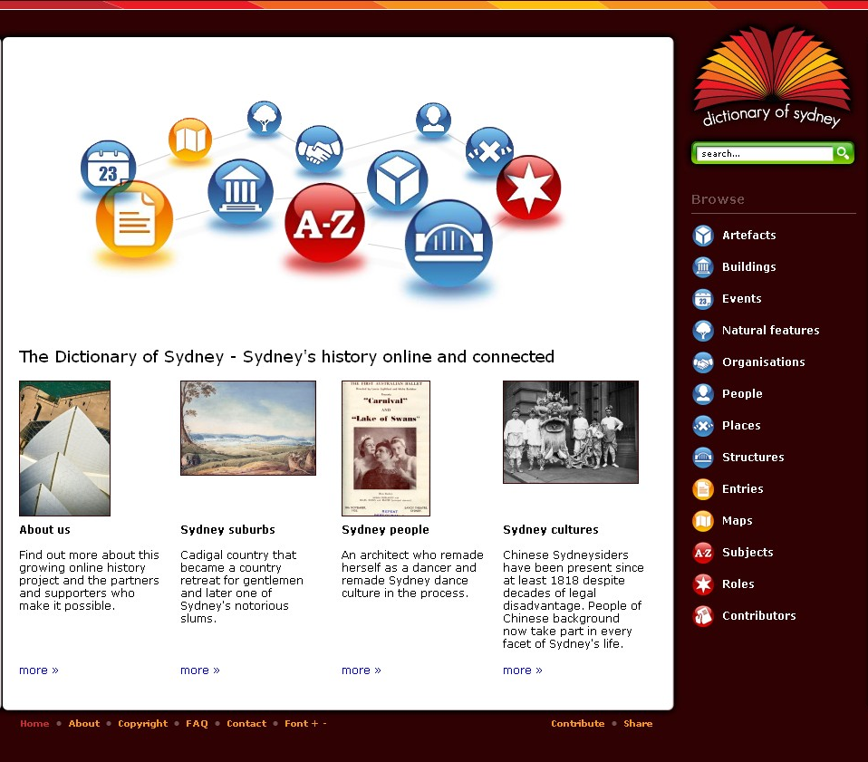
Dictionary of Sydney

Slide 28
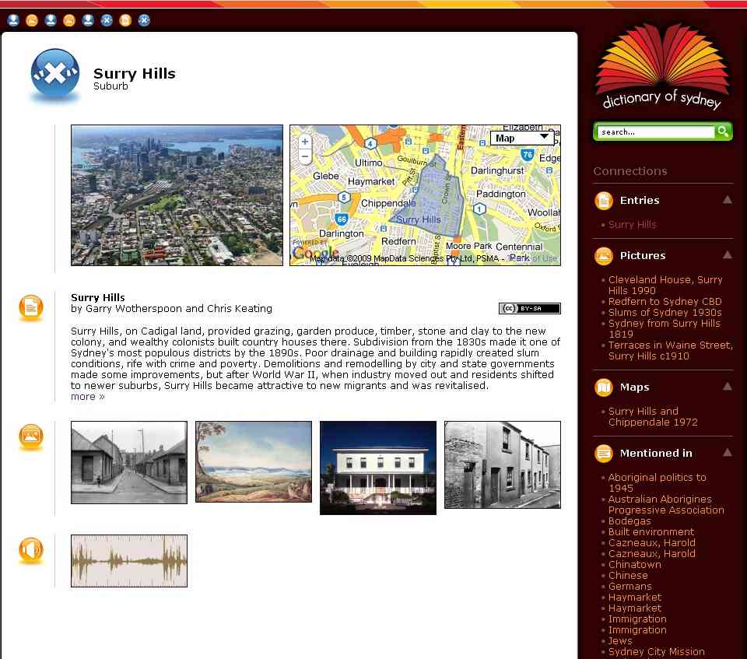
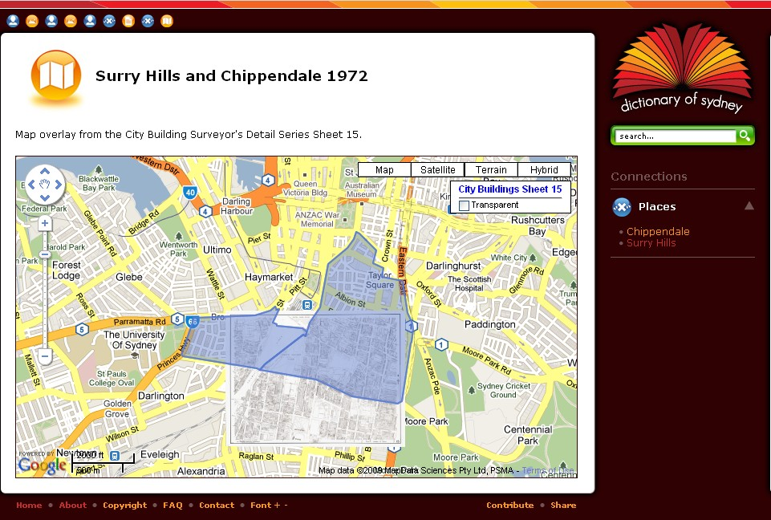
Dictionary of Sydney

Slide 29
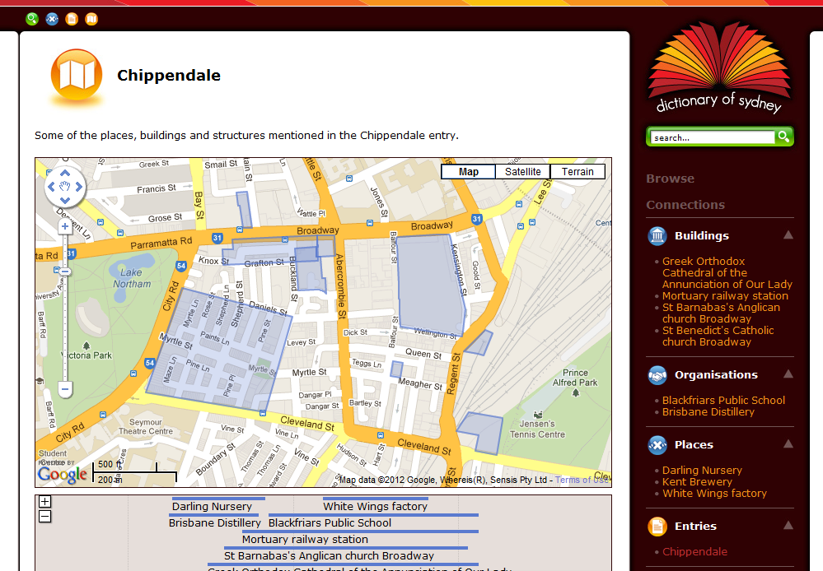
Dictionary of Sydney

Slide 30
Dictionary of Sydney

Slide 31
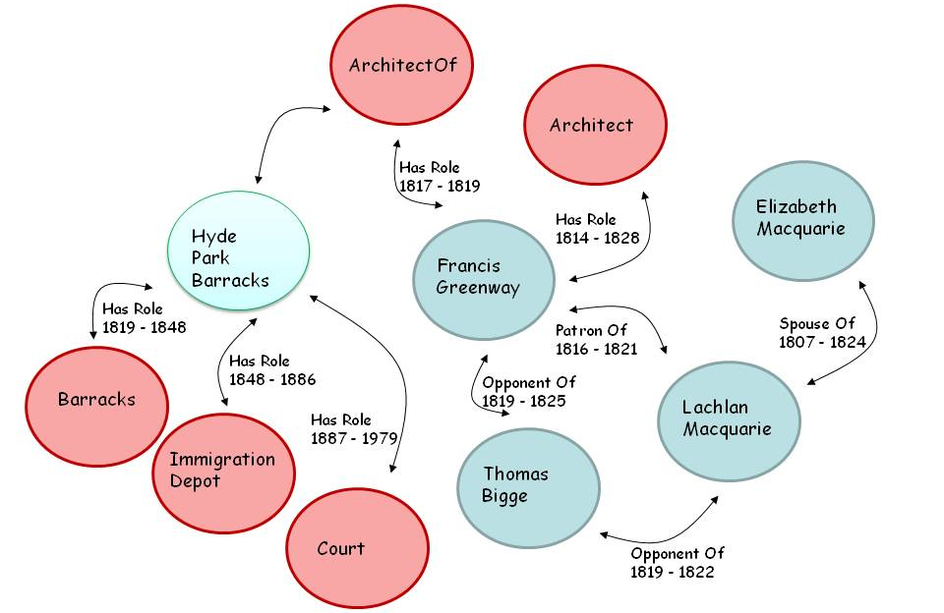
Relationships

Slide 32
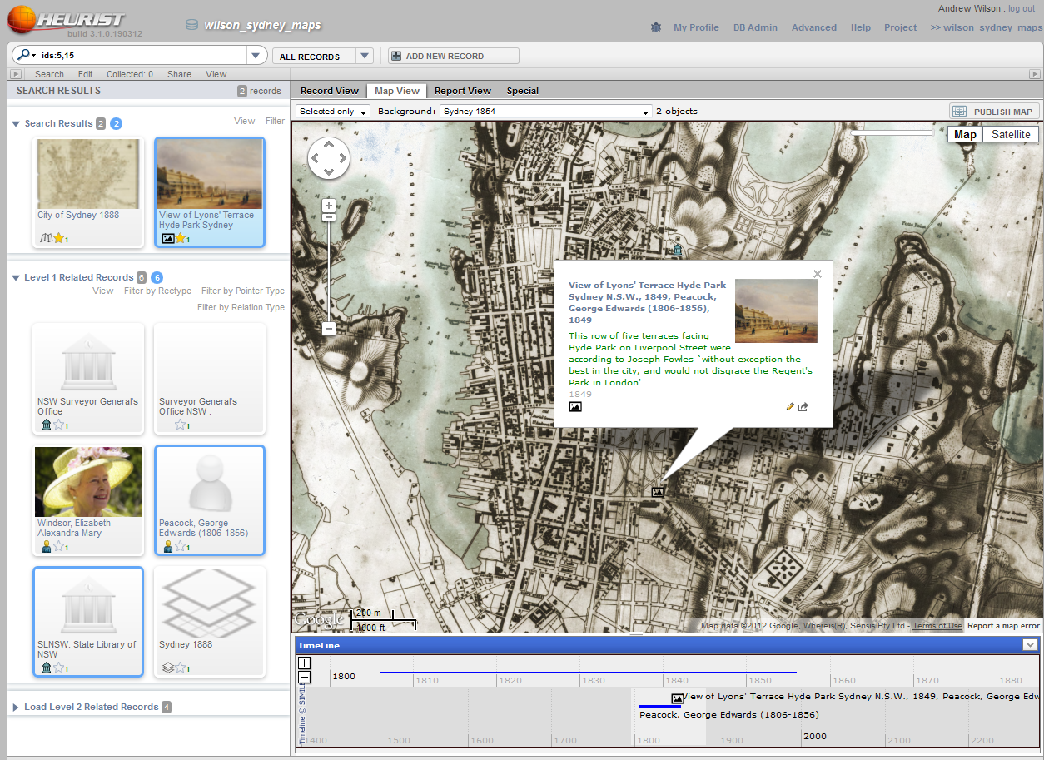

Slide 33
Bali Paintings

Slide 34
Bali Paintings

Slide 35
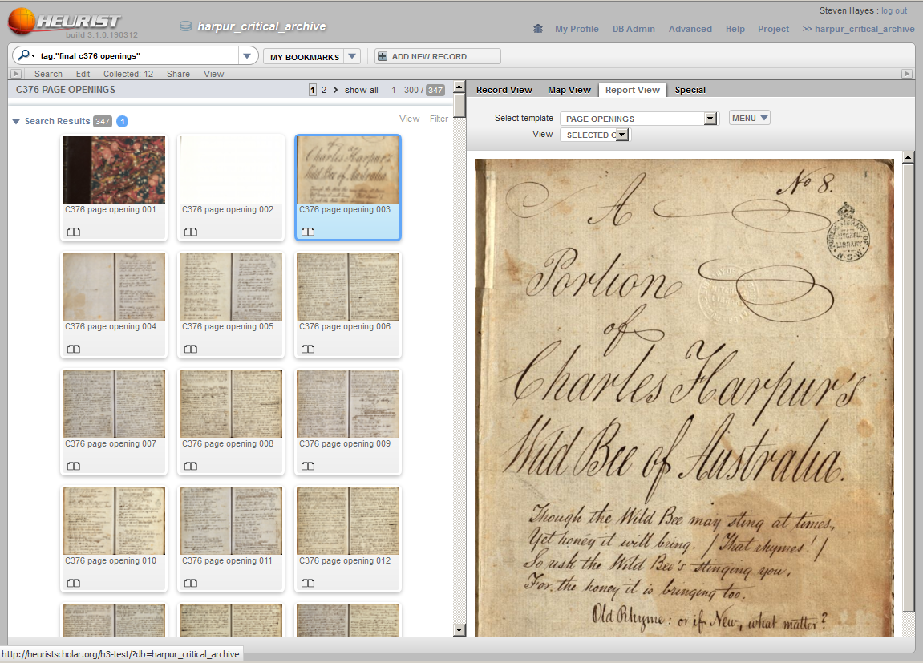
Notes:
The Charles Harpur Critical archive shows Heurist managing the complexity of scholarly critical editions.
Harpur is regarded as the first Australian born poet in the colonial period. The corpus of his work runs to several thousand individual works bound in several manuscripts.
Opening one of the manuscript records presents the viewer with an array of page openings.
Selecting the custom Page Openings template from the Report View allows selections of these page openings to be explored in detail
If a particular page opening is selected to a new window and the Single Page template is selected the viewer can focus his or her studies on one particular work. Here the researcher has selected Singe Page template to better view the original page image.
Related to this page opening are a full transcription record stored in TEI encoding and a Version record (based around the idea of an “Expression” as defined in CIDOC CRM Functional Requirements for Bibliographic Records) .
The viewer can click to the special tab and select the TEI Fragment View which invokes an XSL transform on the underlying XML document allowing the transcription to be easily read. (Note that this is a dynamically rendered fragment of the entire manuscript transcription)
Further down the chain of relations is the Work record which references several other versions of this piece of prose.
The viewer can choose to open one of these version records to see more detail – in this case the original Newspaper Article record which references a PDF

Slide 36
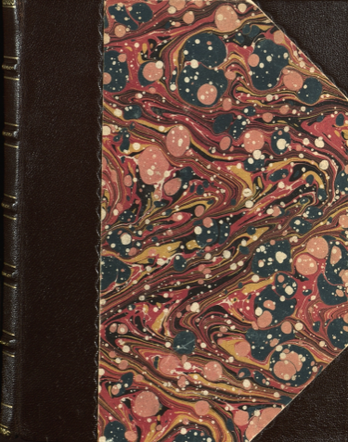
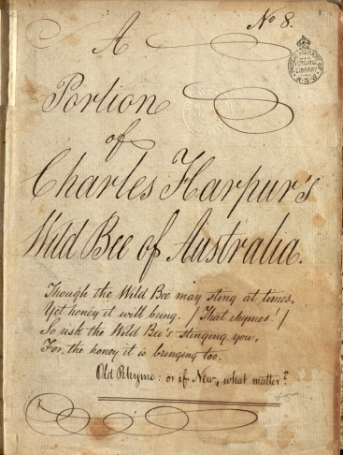
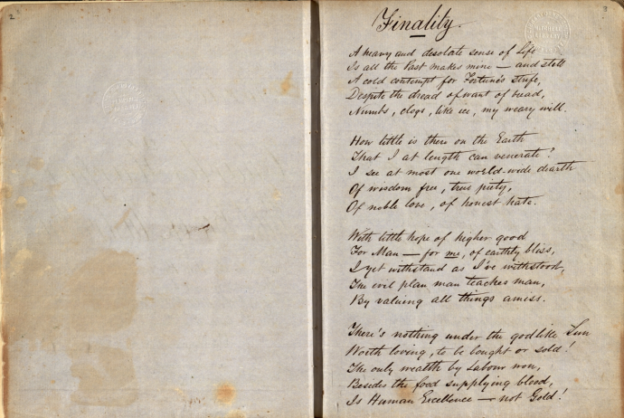
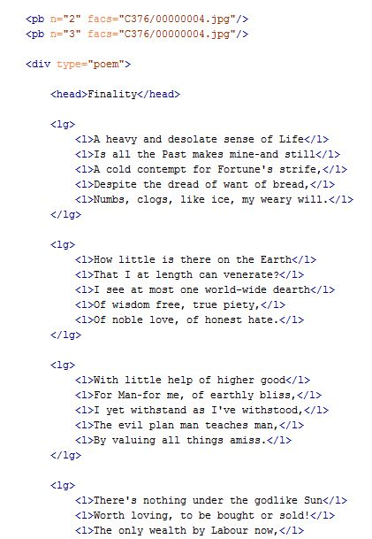
Transcription into TEI
Harpur
Finality
Ver. 1847
Annotation
Ver. 1851-53
Ver. 1853
Ver. 1853-55
Ver. 1859
Select portion of text and link to correct version
Work 2
Object database built from finding list
Work 3

Slide 37
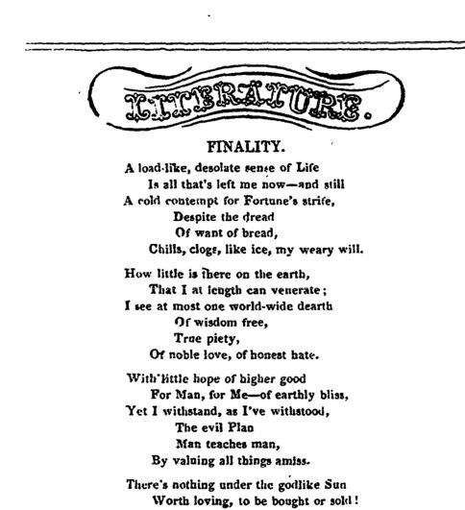
Other versions may exist in archives
Journal
Harpur
Journal edition
Finality
TEI document
Ver. 1847
Annotation
Ver. 1851-53
Ver. 1853
Derived TEI
Ver. 1853-55
Object database expanding
Ver. 1859
Work 2
Work 3

Slide 38
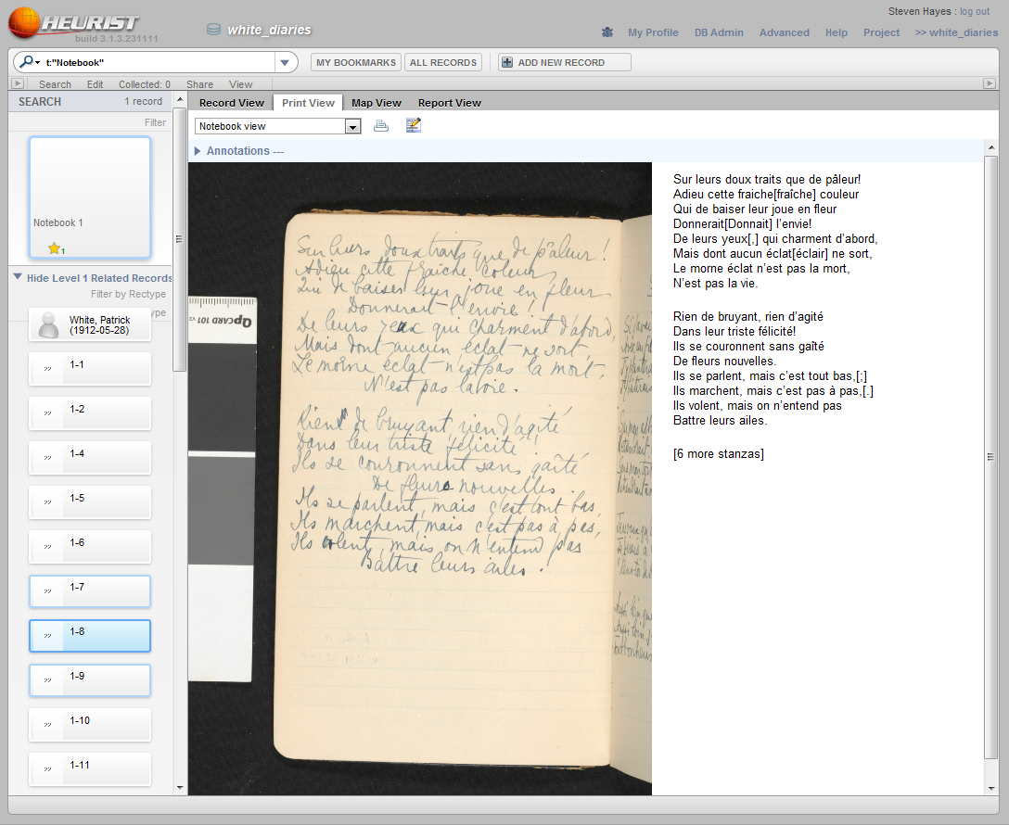
Patrick White Notebooks

Slide 39
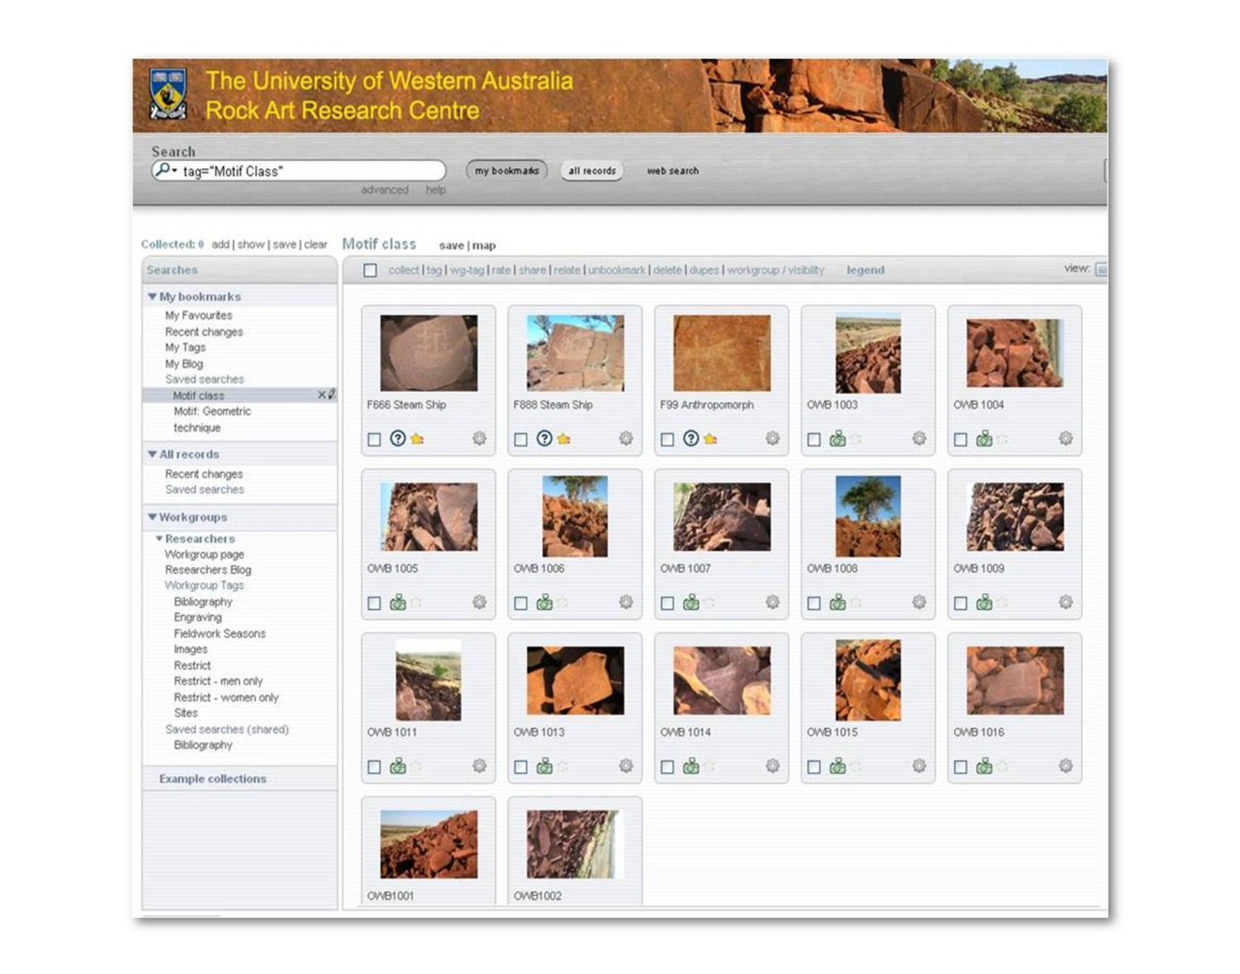

Slide 40
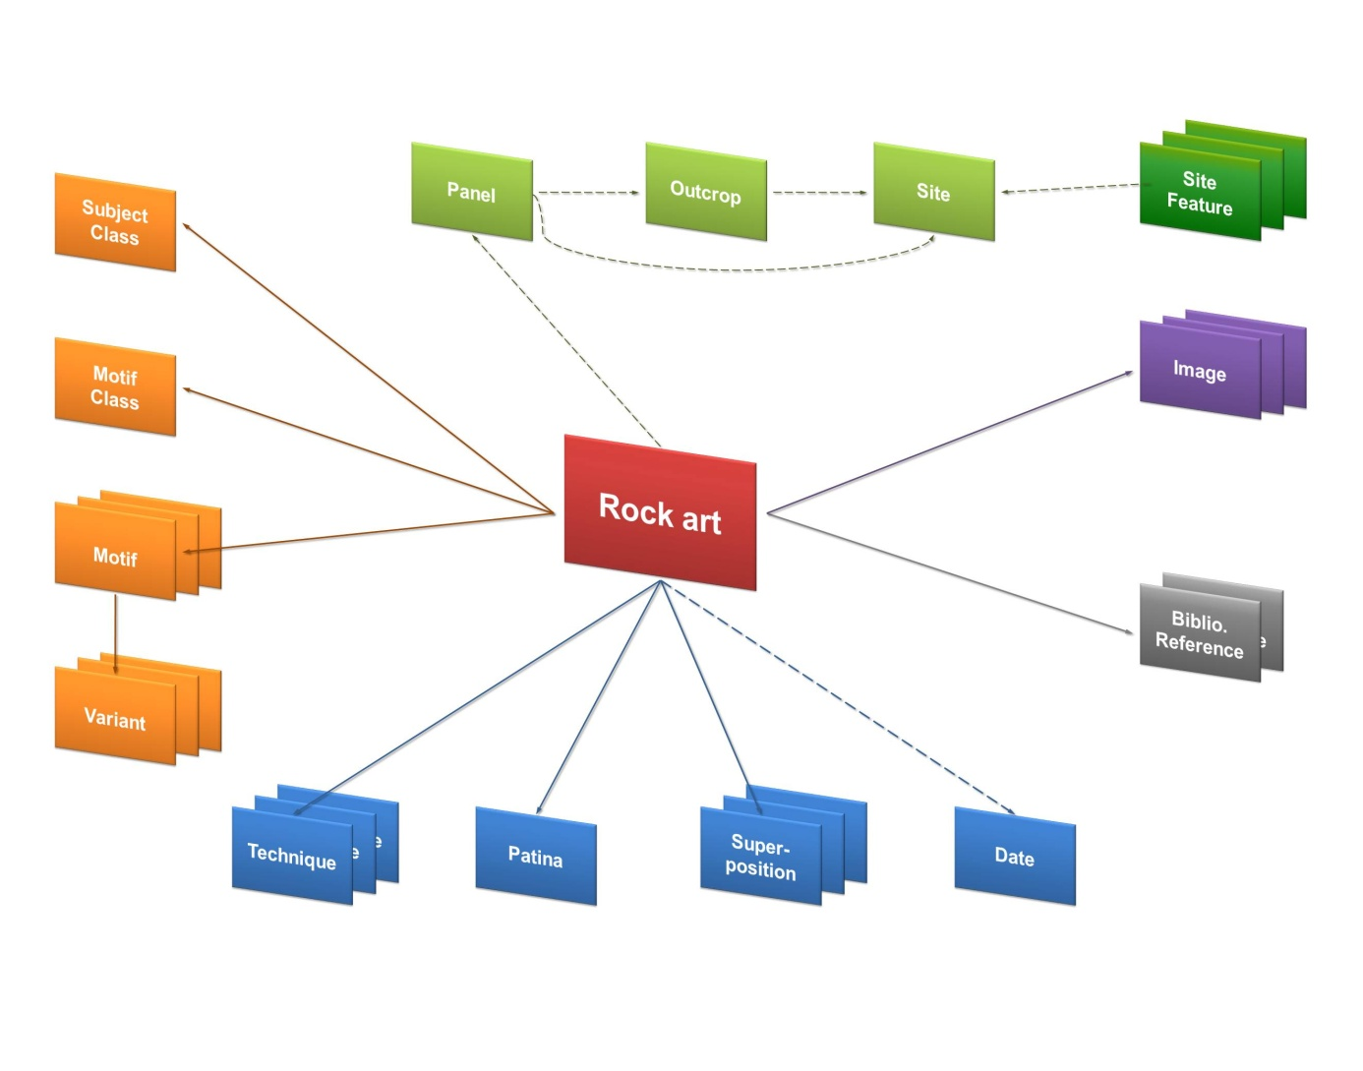

Slide 41
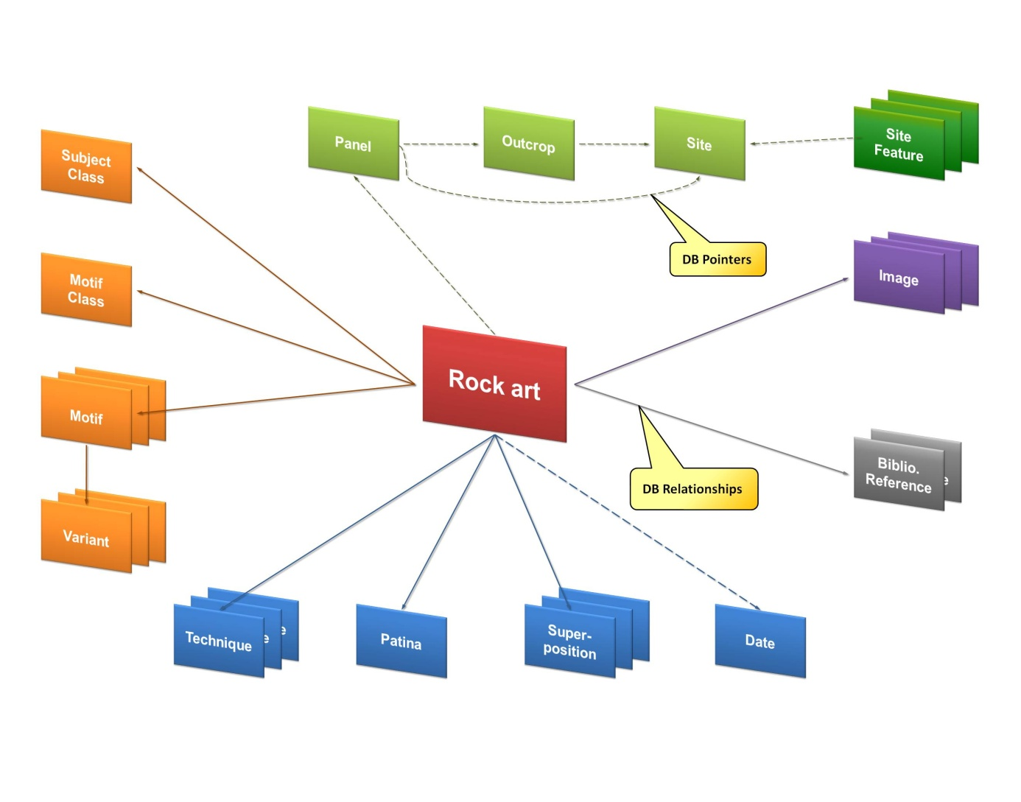

Slide 42
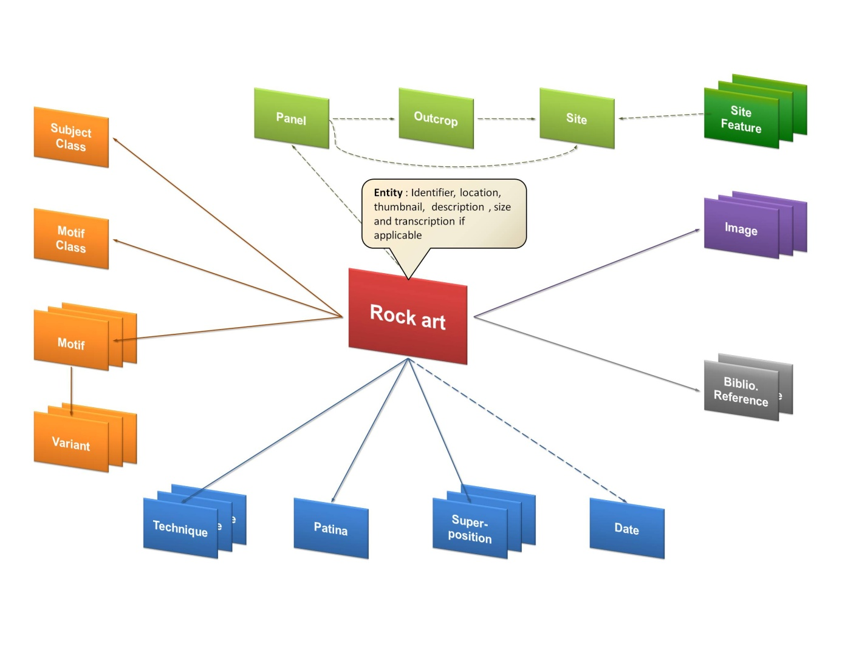

Slide 43


Slide 44


Slide 45


Slide 46


Slide 47


Slide 48


Slide 49


Slide 51


Slide 52


Slide 53


Slide 54


Slide 55


Slide 56
THE ZAGORA DATABASE
HEURIST: A RICH COLLABORATIVE DATABASE

Slide 57






Zagora

Slide 58


Digitized Archival records: 55 note books and registers; 6714 site photographs

Slide 59

1574 artefact drawings

Slide 60

167 architectural plans, maps and isometric reconstructions (J.J. Coulton)

Slide 61

Architectural data in ArcGIS

Slide 62


Gallipoli: The First Day

Slide 63


Slide 64

Notes:
GIS plans

Slide 65

Notes:
Architectural phasing based on wall abutments = social negotiation between families in different housing quarters

Slide 66


Slide 67


Slide 68


Slide 69


Slide 71


Slide 72

Notes:
Replace with new J15 artefacts – update thumbnail for horizon so it fits better

Slide 73


Slide 74


Slide 75


Slide 76


Slide 77


Slide 78


Slide 79


Slide 80


Slide 81


Slide 82


Slide 83


Slide 84


Slide 85


Slide 86


Slide 87


Slide 88


Slide 89


Slide 90


Slide 91


Slide 92


